Slide 1
Beach habitat simulator
By
GC3
Notes:
10 slides in all, 5 on the project management, followed by 5 technical.

Slide 2
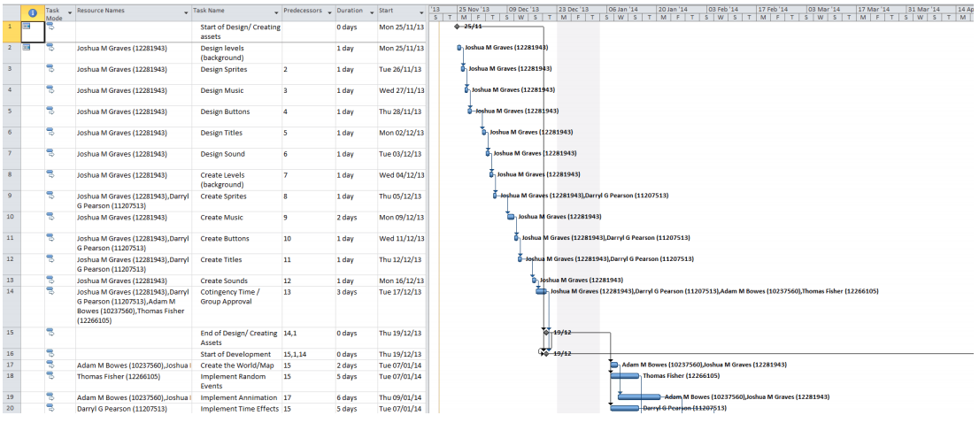
project management
Microsoft project Gantt chart
This is the Gantt chart used to track the project and to ensure everyone knew what to do.
Adam Bowes 10237560 Thomas Fisher 12266105 Darryl Pearson 11207513 Joshua Graves 12281943

Slide 3
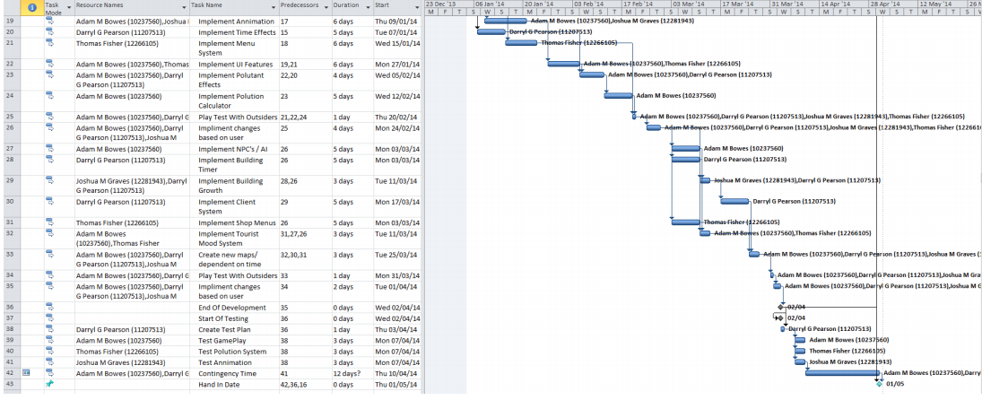
project management
Microsoft project
Throughout the project it became apparent that the timeframes that were set were based on misinformation, so the team moved onto using Facebook as this allowed the team to easily communicate
Adam Bowes 10237560 Thomas Fisher 12266105 Darryl Pearson 11207513 Joshua Graves 12281943

Slide 4
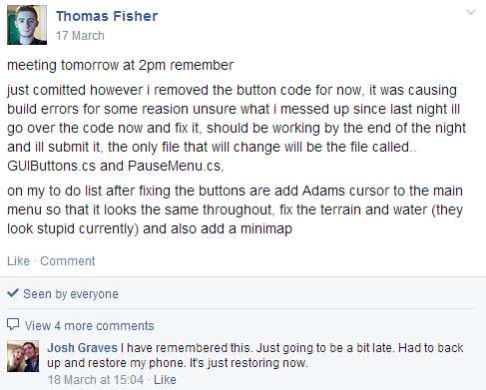
project management
Moving on to Facebook allowed the team to manage its self more effectively.
Facebook allowed the team to delegate tasks to people who would be better suited to them and confront emerging issues.
Adam Bowes 10237560 Thomas Fisher 12266105 Darryl Pearson 11207513 Joshua Graves 12281943

Slide 5
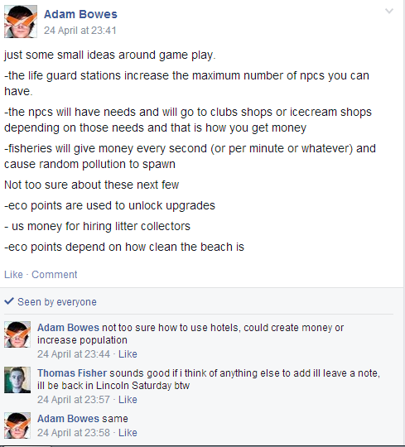
project management
Because the Gantt Chart was no longer in use the critical path of the project was lost leading to some confusion.
While the team was using Facebook some of the issues faced were that ideas were often presented in a informal fashion, this meant that they were often not throughout or ignored.
Adam Bowes 10237560 Thomas Fisher 12266105 Darryl Pearson 11207513 Joshua Graves 12281943

Slide 6
project management
The team had a physical meeting at least once a week, we also held online meetings using Skype.
These meetings allowed the team to have quick clear communication, address issues and ensure that progress was taking place.
Adam Bowes 10237560 Thomas Fisher 12266105 Darryl Pearson 11207513 Joshua Graves 12281943

Slide 7
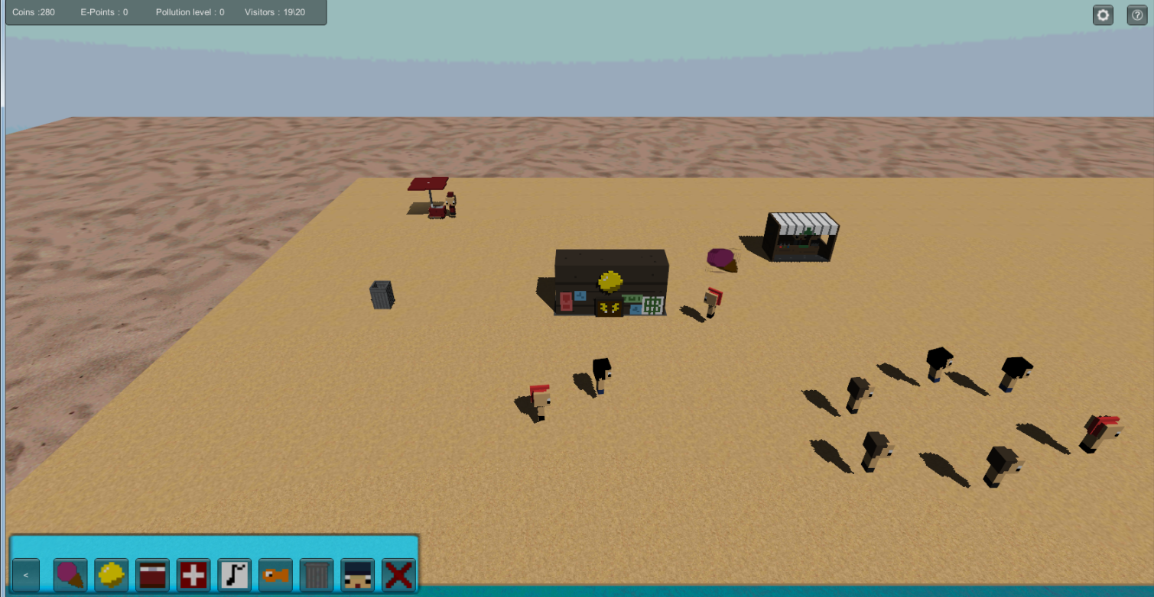
technical
The teams original plan was to create a beach management game in which a player would have to build buildings and manage the beaches money as well as the litter and pollution. This still remains the Core concept of the game.
Adam Bowes 10237560 Thomas Fisher 12266105 Darryl Pearson 11207513 Joshua Graves 12281943

Slide 8
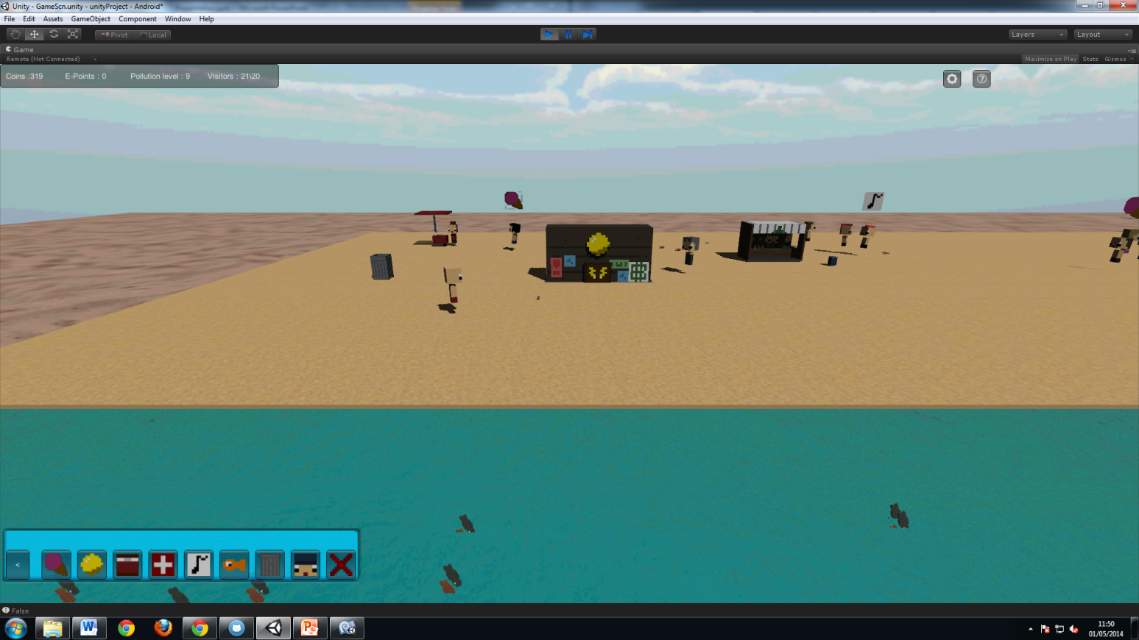
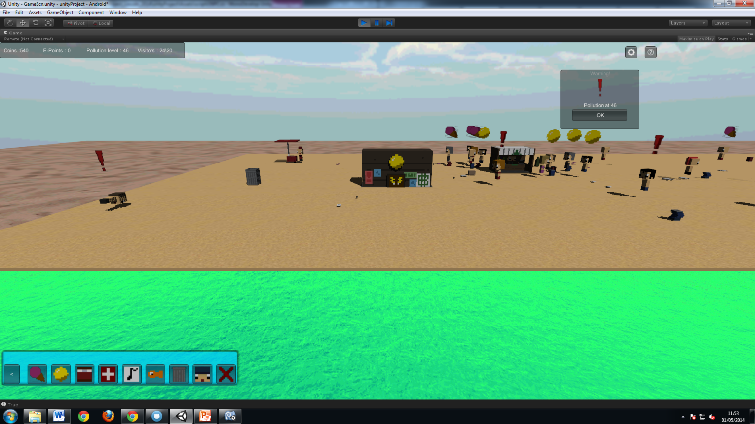
technical
The artefact is in keeping with the initial brief and promotes awareness of marine conservation. This is done through visible litter as well as fish in the see and the colour of the water. Also there is an Eco-points system that indicates the players progress.
Adam Bowes 10237560 Thomas Fisher 12266105 Darryl Pearson 11207513 Joshua Graves 12281943

Slide 9
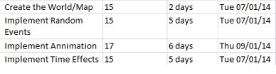
technical
The project plan had some elements that became redundant as the design evolved. Some things like animations turned out to not be required as the art style didn’t allow for it.
Adam Bowes 10237560 Thomas Fisher 12266105 Darryl Pearson 11207513 Joshua Graves 12281943

Slide 10
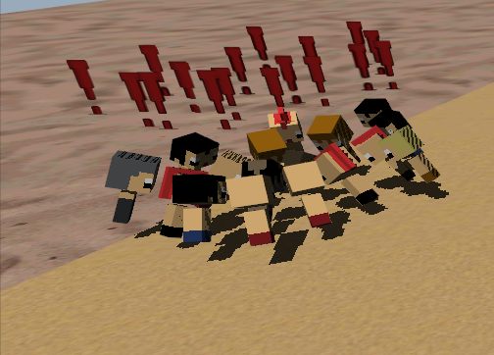
technical
To ensure that the game met the original requirements the game was played by a group of individuals during a play testing session, they were asked what they thought of the message and if they had found any bugs.
Adam Bowes 10237560 Thomas Fisher 12266105 Darryl Pearson 11207513 Joshua Graves 12281943

